Slide 1
MPXV 논문 요약(2)
2024.08.02
Sol Kim

Slide 2
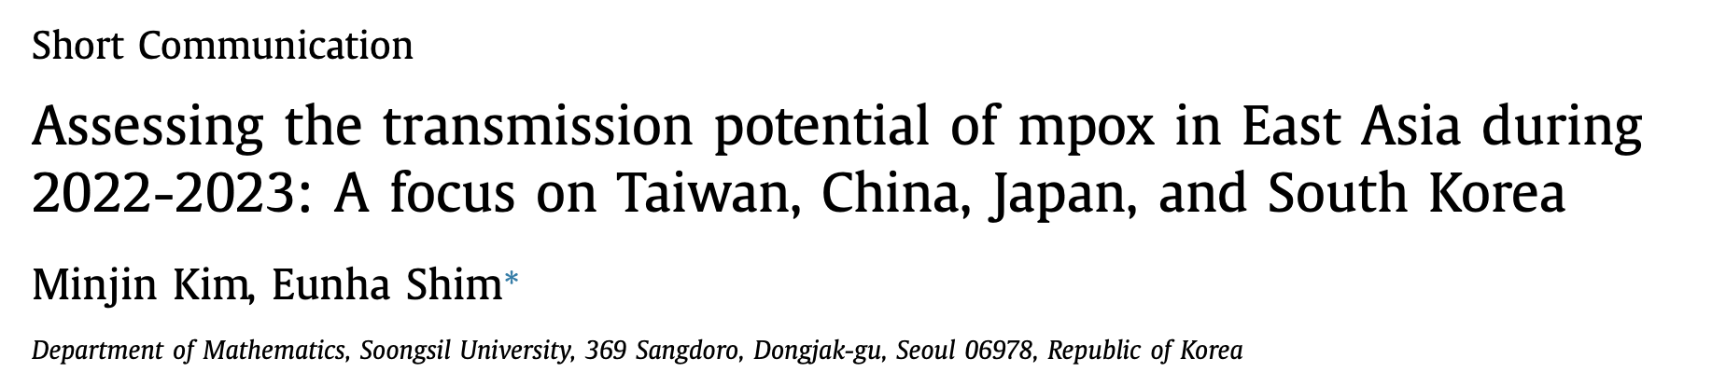
Identify the question
This study aims to estimate the transmission potential(Rt) of mpox in East Asia (Taiwan, China, Japan, and South Korea)
Identify existing knowledge
the case incidence during the initial 30 epidemic days.
Method
The best-fit model was selected to calculate the reproduction number (Rt ). Additionally, we used the latest case data and a Bayesian framework(코리네 방법) to compute the instantaneous effective Rt
Notes:
Abstract 만 읽고 예상 해보길 : 4국가의 R_t를 계산해보고 예측하기 위해 모델을 6개를 만들어놓고 그중에 가장 데이터를 잘 설명하는 모델을 선택하고 그것으로 R_t를계산해봤다?
추가적으로 최신 데이터를 이용하여 앞으로를 예측해볼때는 코리네 방법을 사용했다.
결론은 국가의 관리가 매우 중요하단다
six phenomenological dynamic growth models\
발병 후 초기 30일의 case, incidence data에 6가지 dynamic models을 피팅하여 transmission potential을 추정하였다.

Slide 3
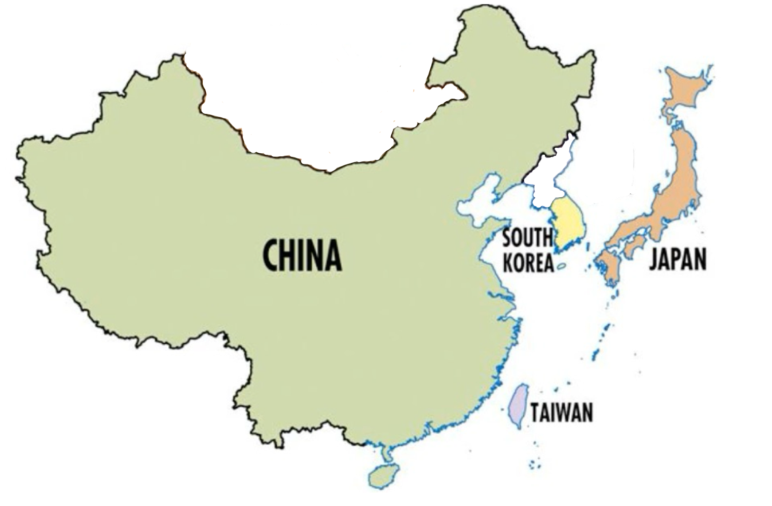

Slide 4
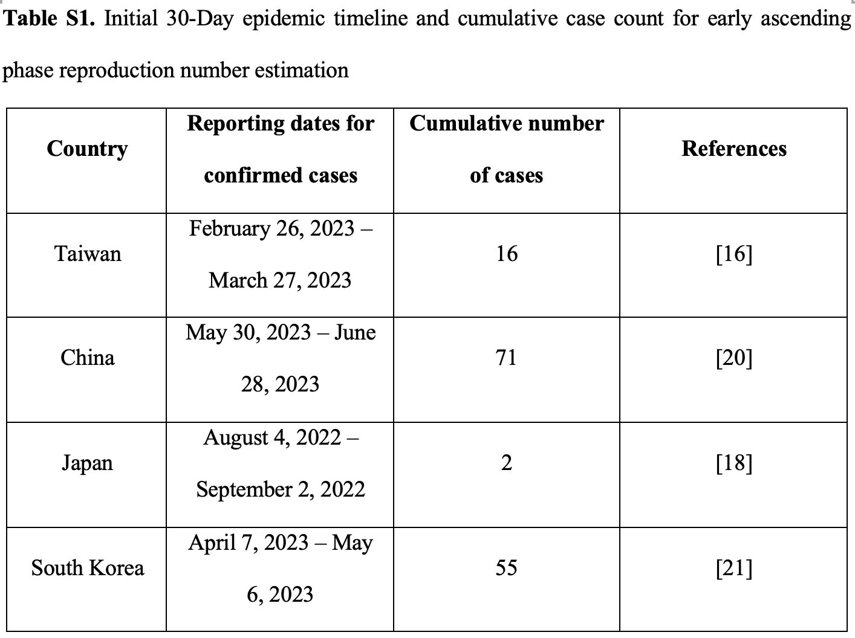
The first local case reported
China
71
Korea
55
Taiwan
16
Japan
2
2022
08.04
2023
02.26
2023
04.07
2023
05.30

Slide 5
Candidate Models for evaluation
Model Evaluation Metrics
GGM, generalized growth model
LM, logistic growth model
GLM, generalized logistic growth model
RICH, Richards model
GRM, generalized Richards model
GOM, Gompertz model
Metrics employed for this evaluation encompassed
mean absolute error (MAE)
mean squared error (MSE)
the coverage of the 95% prediction intervals (95% PI)
the weighted interval score (WIS)
the Akaike Information Criterion (AIC)
For each model, superior performance was indicated by a higher 95% PI coverage and lower values of MAE, MSE, WIS, and AIC.

Slide 6
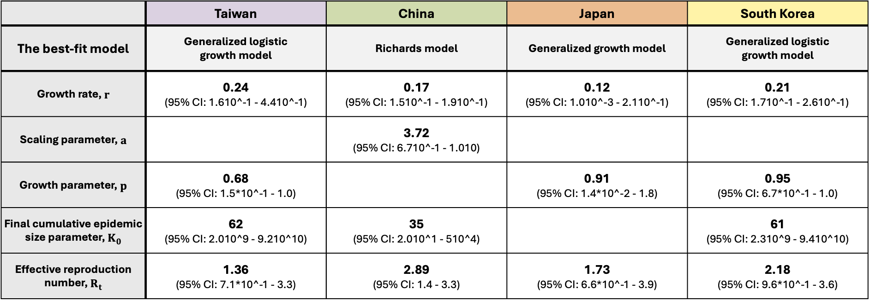
 | Taiwan | China | Japan | South Korea
The best-fit model | Generalized logistic growth model | Richards model | Generalized growth model | Generalized logistic growth model
Growth rate, $r$ | 0.24 (95% CI: 1.610^-1 - 4.410^-1) | 0.17 (95% CI: 1.510^-1 - 1.910^-1) | 0.12 (95% CI: 1.010^-3 - 2.110^-1) | 0.21 (95% CI: 1.710^-1 - 2.610^-1)
Scaling parameter, $a$ |  | 3.72 (95% CI: 6.710^-1 - 1.010)
Growth parameter, $p$ | 0.68 (95% CI: 1.5*10^-1 - 1.0) |  | 0.91 (95% CI: 1.4*10^-2 - 1.8) | 0.95 (95% CI: 6.7*10^-1 - 1.0)
Final cumulative epidemic size parameter, $K_{0}$ | 62 (95% CI: 2.010^9 - 9.210^10) | 35 (95% CI: 2.010^1 - 510^4) |  | 61 (95% CI: 2.310^9 - 9.410^10)
Effective reproduction number, $R_{t}$ | 1.36 (95% CI: 7.1*10^-1 - 3.3) | 2.89 (95% CI: 1.4 - 3.3) | 1.73 (95% CI: 6.6*10^-1 - 3.9) | 2.18 (95% CI: 9.6*10^-1 - 3.6)

Slide 7
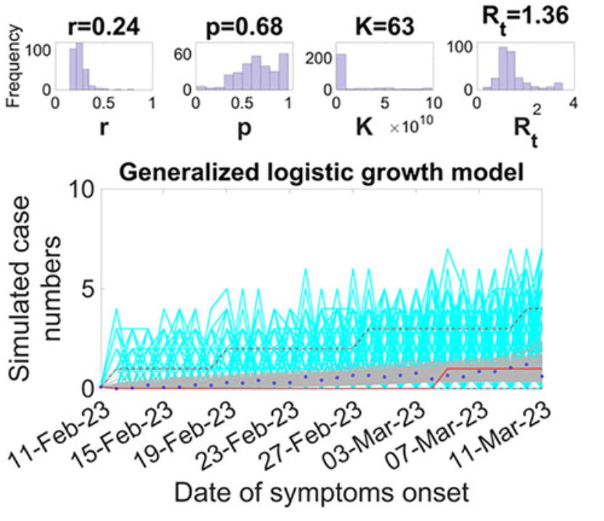
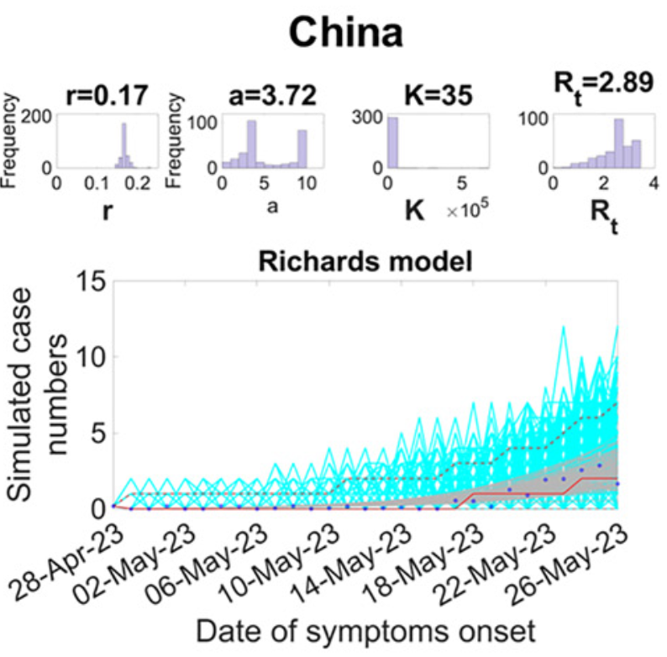
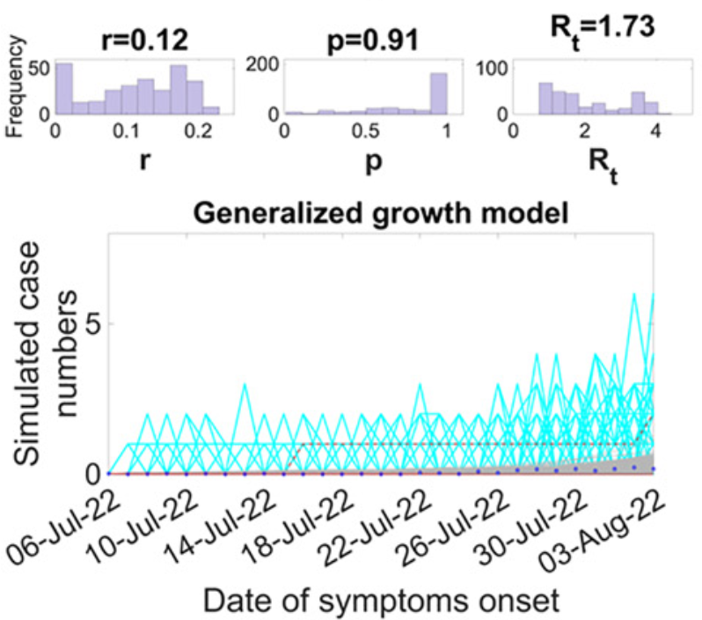
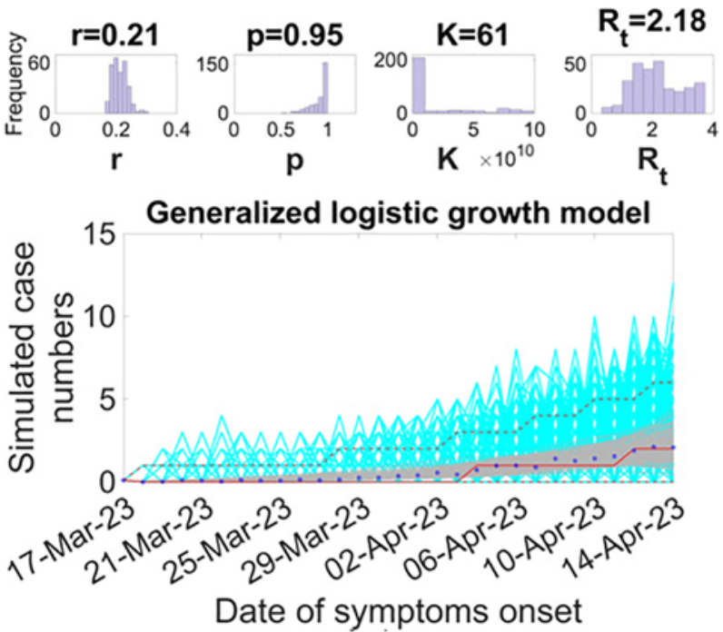
China
71
Korea
55
The first local case reported
Taiwan
16
Japan
2
2022
08.04
2023
02.26
2023
04.07
2023
05.30
Taiwan | China | Japan | South Korea
2022.08.04

Slide 8
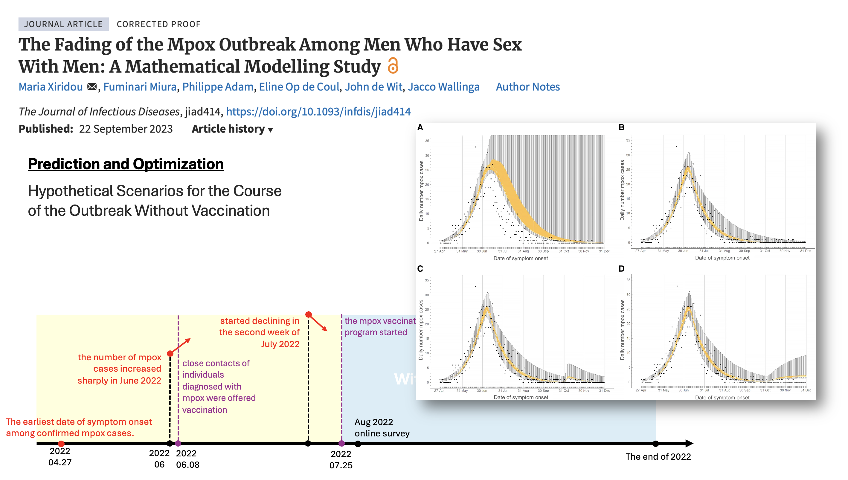
PLAN

